Slide 1
INDUSTRIAL TRAINING PROJECT
BRAIN TUMOR ANALYSIS MACHINE LEARNING MODEL

Slide 2
OBJECTIVE
BUILD A MODEL USING MACHINE LEARING ALGORITHM FOR PREDICTING BRAIN TUMOR ANALYSIS

Slide 3
Introduction
What is Machine Learning and why we are using it ?
Machine learning (ML) is a field of artificial intelligence that uses statistical techniques to give computer systems the ability to "learn" (e.g., progressively improve performance on a specific task) from data, without being explicitly programmed.

Slide 4


Slide 5
BRAIN Cancer: An overview
One of the most common cancer worldwide.
Early detection is the most effective way to reduce brain tumor deaths.
Early diagnosis requires an accurate and reliable procedure to distinguish between benign brain tumors from malignant ones.

Slide 6
Breast Cancer Types
Some types of brain tumors:
  Benign brain tumors
  Meningioma (most common in women)
  Glioblastoma(most common in men)

Slide 7
Magnetic resonance imaging (MRI) is commonly used to help diagnose brain tumors. It is Non Invasive and painless procedure.
Benign Cancer are non-cancerous growths and cannot spread outside of the brain to other organs.
Malignant primary brain tumors are cancers that originate in the brain, typically grow faster than benign tumors, and aggressively invade surrounding tissue. Although brain cancer rarely spreads to other organs, it can spread to other parts of the brain and central nervous system.
This analysis assists in differentiating between benign and malignant tumors.

Slide 8
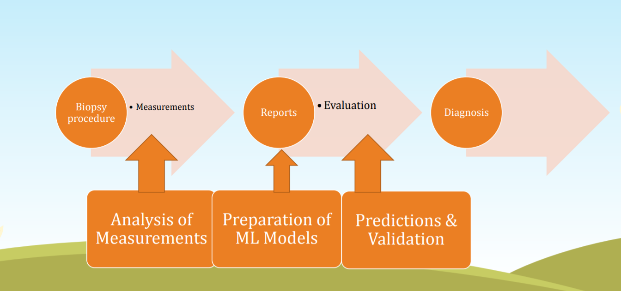
Flow chart

Slide 9
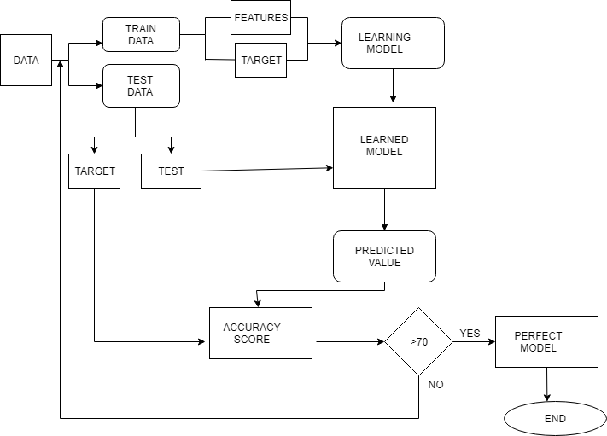
DATA FLOW DIAGRAM

Slide 10
DATA SOURCE
https://archive.ics.uci.edu/ml/datasets/Breast+Cancer+Wisconsin+(Diagnostic)
The data used for this POC is from University of Wisconsin.
This brain cancer database was obtained from the University of Wisconsin Hospitals, Madison from Dr. William H. Wolberg

Slide 11
Analysis with Google Colaboratory
(using Python)
Step 1 – collecting data
We will utilize the Wisconsin Brain Cancer Diagnostic dataset from the UCI Machine Learning Repository at http://archive.ics.uci.edu/ml. This data was donated by researchers of the University of Wisconsin. The breast cancer data includes 569 examples of cancer biopsies, each with 30 features.

Slide 12
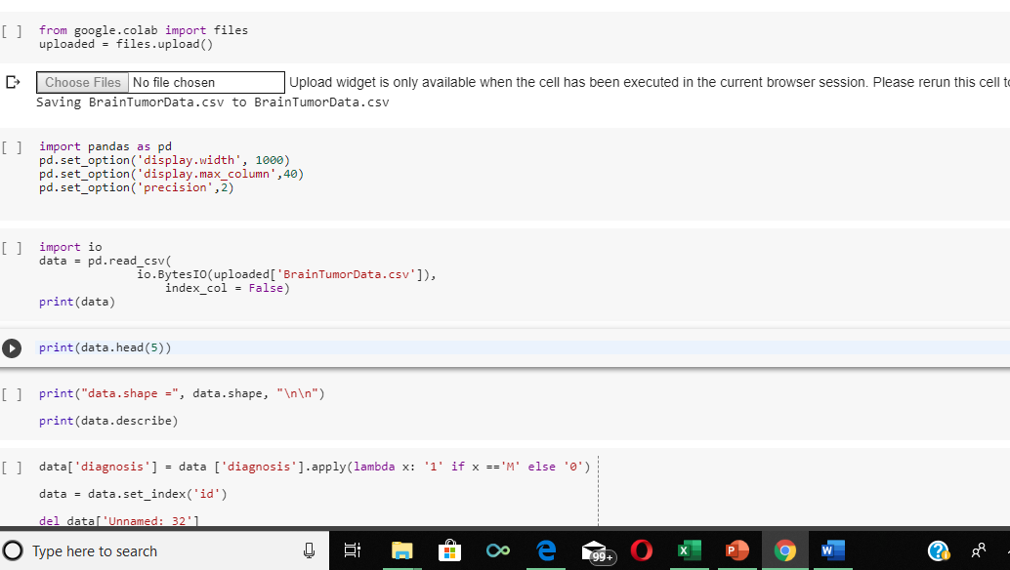
Step 2 – exploring and preparing the data

Slide 13

The output indicates that 357 masses are benign(0) while 212 are malignant(1)

Slide 14
Data preparation – creating training and test datasets
from sklearn.model_selection import train_test_split
X_train,X_test,Y_train,Y_test = train_test_split(X,Y,test_size = 0.33)

Slide 15
Algorithm:- Classification Using Logistic Regrssion
When it comes to Logistic Regression classification, we are determining the probability of an observation to be part of a certain class or not. Therefore, we wish to express the probability with a value between 0 and 1.
Spam detection is a binary classification problem where we are given an email and we need to classify whether or not it is spam.
Probability of passing an exam versus hours of study.
A Logistic Regression classifier may be used to identify whether a tumour is malignant or if it is benign.

Slide 16
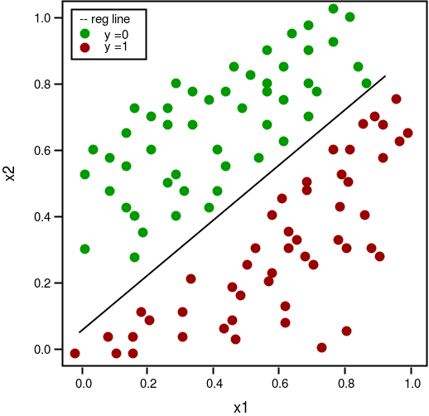
Logical Regression classifiers Example

Slide 17
Step 3 – Training a model on the data
from sklearn import linear_model
model = linear_model.LogisticRegression()
Step 4-Testing the model on the data
predictedY = model.predict(X_test)

Slide 18
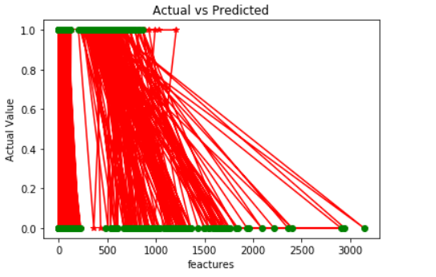
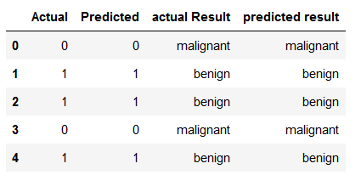
Actual Result vs Predicted Result

Slide 19
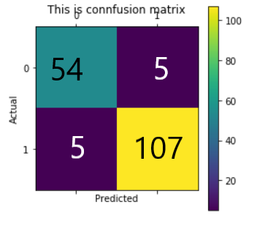

Confusion Matrix to calculate Accuracy
Confusion matrix | Predicted 0 | Predicted 1
Actual 0 | True Negative=54 | False positive=5
Actual 1 | False Negative=5 | True positive=107
Accuracy:-
(TN+TP)
(TP+TN+FP+FN)

Slide 20
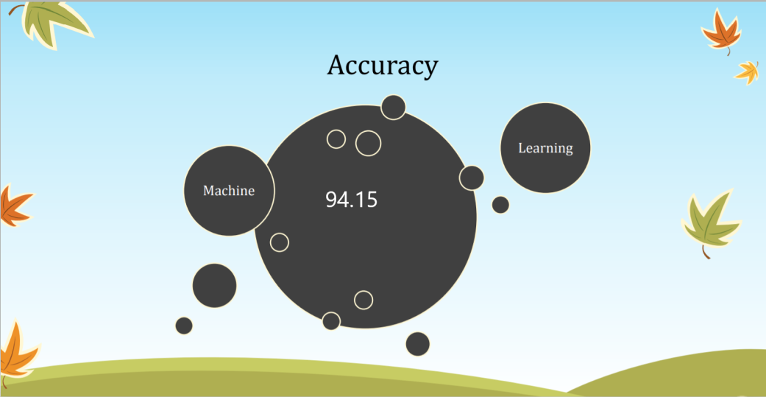

Slide 21
THANK YOU

